Slide 1
Accurate Prediction of Sepsis in ICU Patients
Sneha Bamane
Shweta Maharanawar
Devyani Pathrikar
Guide- Prof. Mugdha Rane

Slide 2
CONTENTS
Problem definition
Requirement specification and tools used
literature survey
System design details (UML diagrams) and architecture diagram
System implementation – code documentation – data flow diagrams/ algorithm, protocols used
Test result and procedure – test report as per ATP.
Conclusions.

Slide 3
PROBLEM STATEMENT
To develop a robust prediction system that can reliably identify the early signs and risk factors for sepsis in ICU patients is essential for timely intervention and improved patient outcomes.

Slide 4
REQUIREMENT SPECIFICATION AND TOOLS
HARDWARE : 1. System : Intel i5 or above
2. RAM : 4GB or above SOFTWARE : 1. Operating System : Windows 11 or any open source OS
2. Development Tool : Visual Studio & Jupyter Notebook
3. Programming Language: Python (Flask Framework)
4.Database: SQLite

Slide 5
LITERATURE SURVEY
Title | Author | Publication | Remark
Early Prediction of Sepsis using Machine Learning | Anuraag Shankar, Mufaddal Diwan, Snigdha Singh, Husain Nahrpurawala and Tanusri Bhowmick | IEEE, 2021 | The paper introduces the importance of the SOFA score and the challenges in timely diagnosis, serving as a basis for our project.
IEEE A Comprehensive Machine Learning Based Pipeline for an Accurate Early Prediction of Sepsis in ICU | B. C. SRIMEDHA , RASHMI NAVEEN RAJ , AND VEENA MAYYA | IEEE Access, 2022 | This research by investigating four prediction algorithms, including Random Forest, Logistic Regression, Gradient Boosting, and Decision Tree, and examining the impact of various imputation techniques,

Slide 6
Title | Author | Publication | Remark
Using machine learning methods to predict in-hospital mortality of sepsis patients in the ICU | Guilan Kong, Ke Lin and Yonghua Hu | 2020, Published by BMC. | This study focuses on leveraging machine learning techniques to predict the in-hospital mortality of sepsis patients in the ICU. Machine learning models, including LASSO, RF, GBM, and traditional LR.
A Machine Learning Model for Early Prediction and Detection of Sepsis in Intensive Care Unit Patients | Yash Veer Singh , Pushpendra Singh , Shadab Khan , and Ram Sewak Singh | 2022, Published by Hindawi. | This paper introduces a machine learning model for early sepsis prediction in ICU patients, leveraging data from clinical laboratory values and vital signs. Various models, including SVM, RF, NB, LR, and XGBoost, are examined.
Early Prediction of Mortality, Severity, and Length of Stay in the Intensive Care Unit of Sepsis Patients Based on Sepsis 3.0 by Machine Learning Models | Longxiang Su, Zheng Xu, Fengxiang Chang, Yingying Ma, Shengjun Liu , Huizhen Jiang, Hao Wang, Dongkai Li , Huan Chen, Xiang Zhou, Na Hong, Weiguo Zhu, and Yun Long | 28 June 2021, Published by Frontiers in Medicine | This study centers around harnessing machine learning techniques to anticipate in-hospital mortality among sepsis patients in the ICU. Several machine learning models were constructed for this purpose.

Slide 7
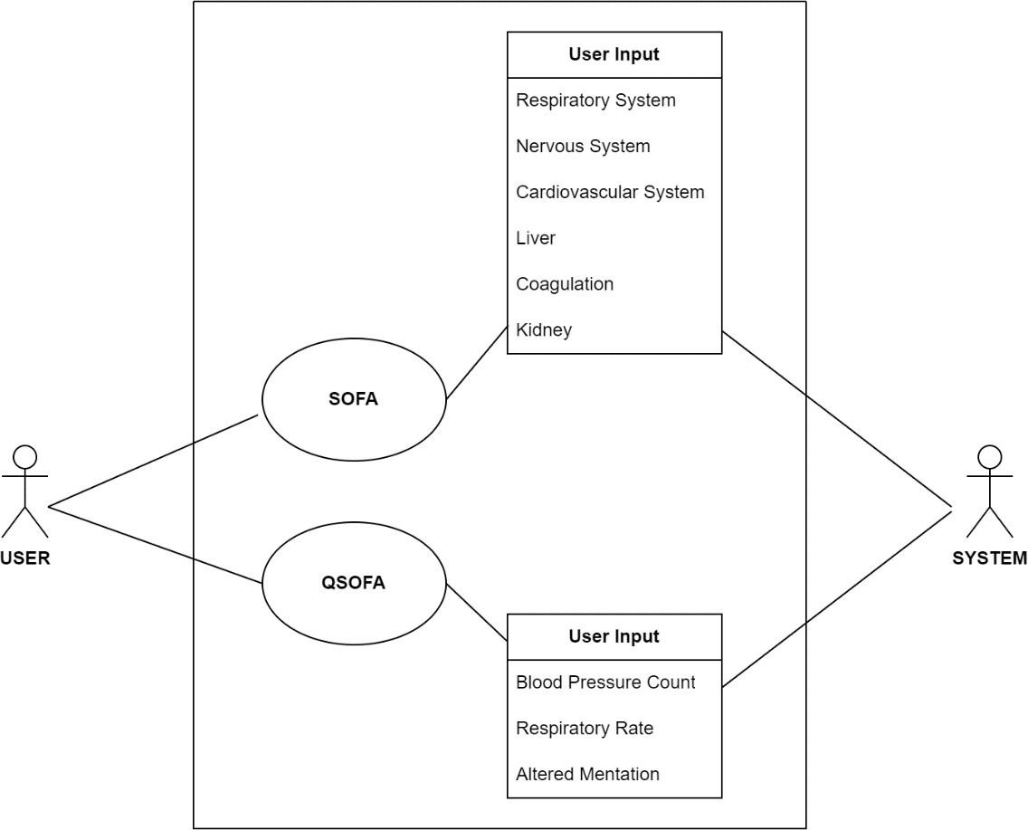
UML DIAGRAMS
Use Case Diagram:

Slide 8
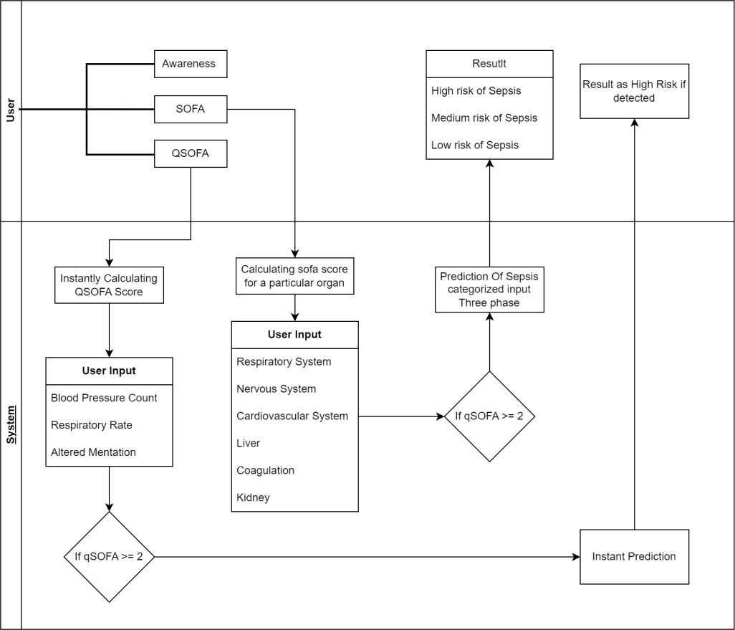
Class Diagram:

Slide 9
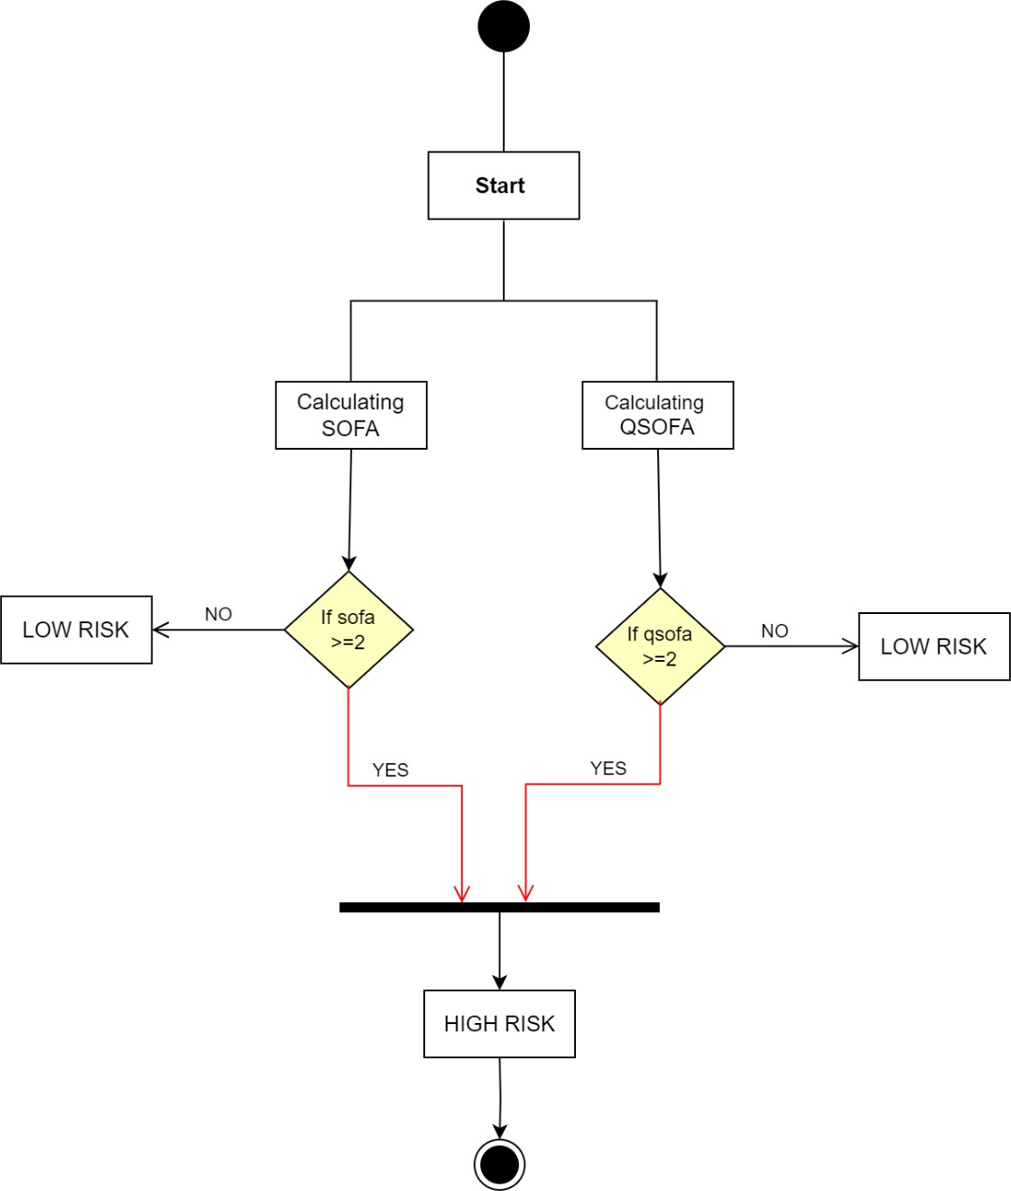
Activity Diagram:

Slide 10
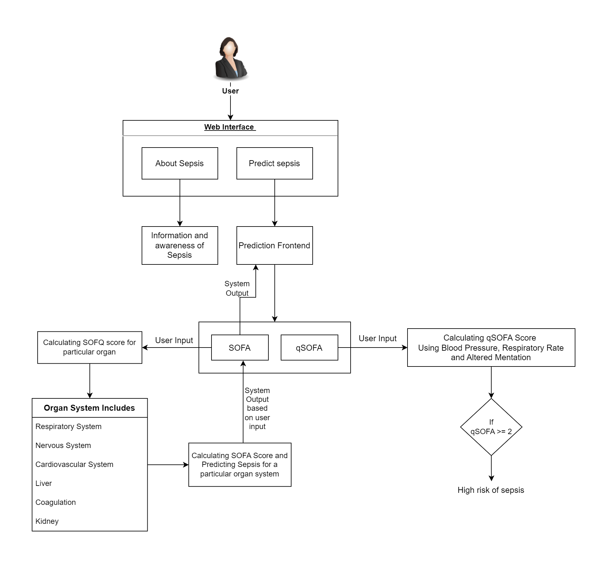
SYSTEM ARCHITECTURE DIAGRAM

Slide 11
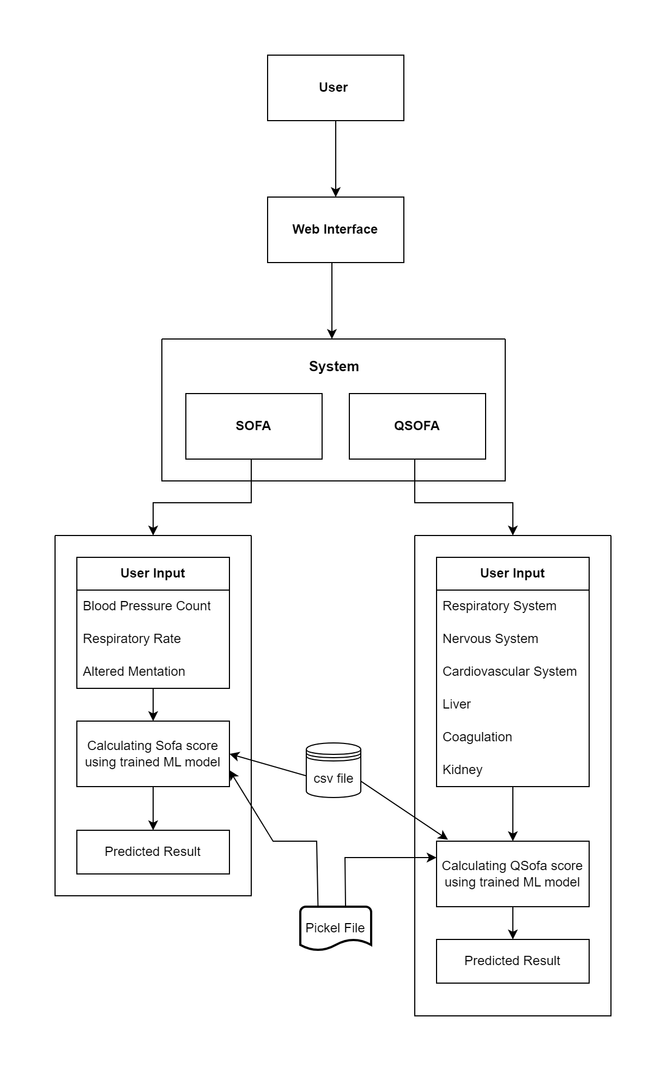
DATA FLOW DIAGRAM

Slide 12
METHODOLOGY
Data Collection
Clean And Preprocess The Data
Select Relevant Features
Choose Random Forest As Model
Model Training

Slide 13
ALGORITHM
Random Forest is machine learning algorithm that builds multiple decision trees during training and merges their results to improve accuracy and control overfitting.
In the context of sepsis prediction, model can analyze complex and high-dimensional healthcare data to make accurate predictions of sepsis in patients.
Predictive Modelling: It builds a predictive model aimed at determining the likelihood of a patient developing sepsis during their ICU stay, based on diverse patient-related factors and clinical data.
Feature Selection: It can help identify which patient variables or features are most relevant for predicting sepsis.
Risk Stratification: It helps in stratifying patients into different risk categories based on their calculated SOFA scores.

Slide 14
TEST CASES
No. | Functional Test Cases | Actual Output | Expected Output | Test Status
1 | Verify if the User is able to see the complete UI of the system. | The UI is visible. | The UI is visible. | Pass
2 | Verify if sepsis is detected with low risk. | Sepsis detected with low risk. | Sepsis detected with low risk. | Pass
3 | Verify if sepsis is detected with medium risk. | Sepsis detected with medium risk. | Sepsis detected with medium risk. | Pass

Slide 15
4 | Verify if sepsis is detected with high risk. | Sepsis detected with high risk. | Sepsis detected with high risk. | Pass
5 | Verify Admin login working properly. | Works properly. | Works properly. | Pass
6 | Verify user data is saved in database. | Data saved successfully. | Data saved successfully. | Pass
7 | Verify if the training model is giving good accuracy or not | Showed Accuracy of 85% | Should show accuracy of minimum 80% | Pass

Slide 16
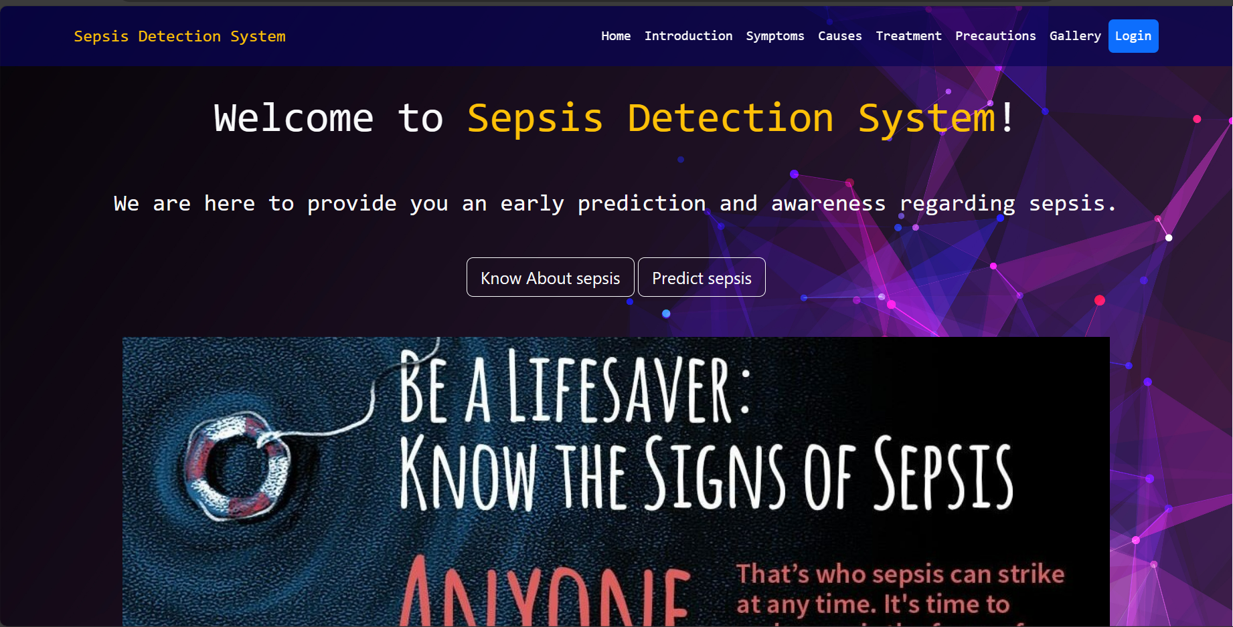
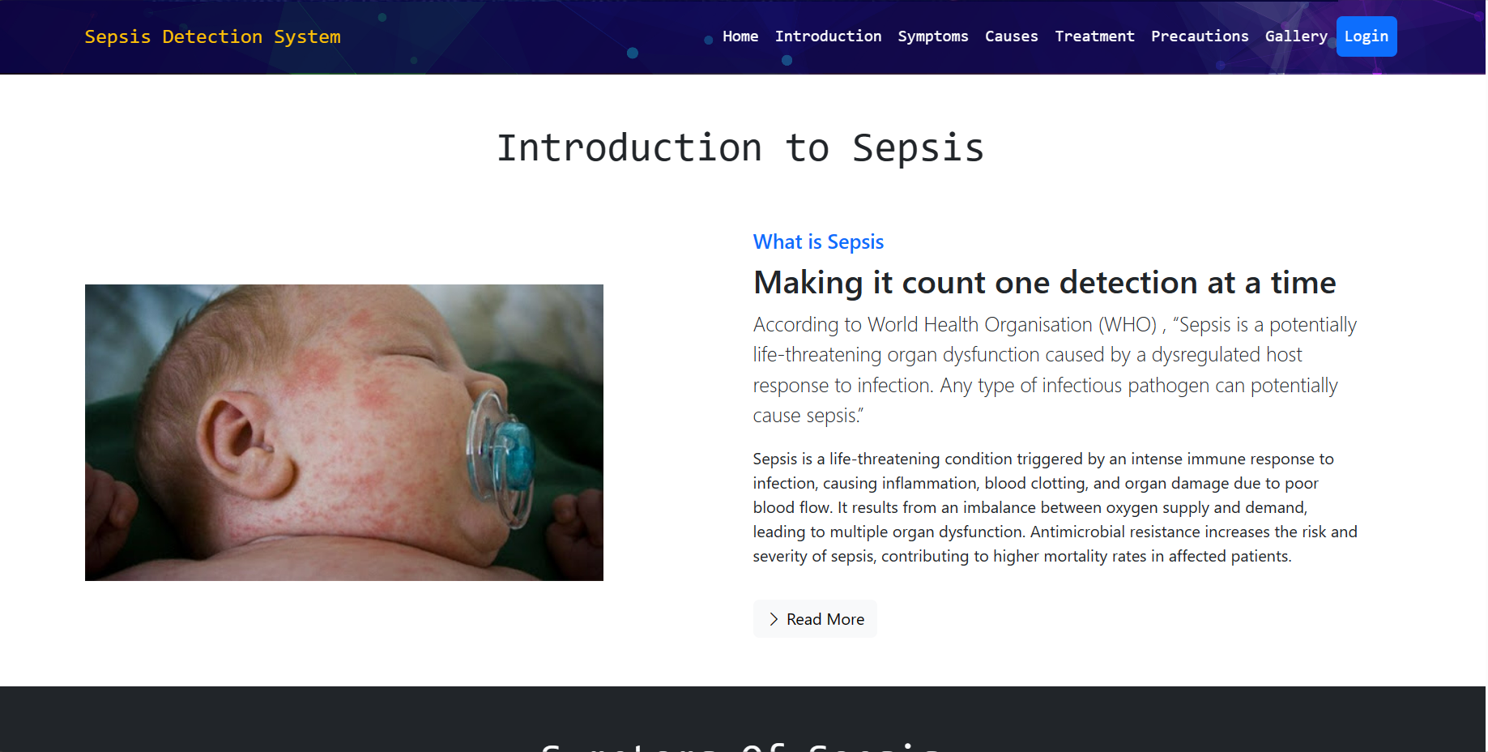
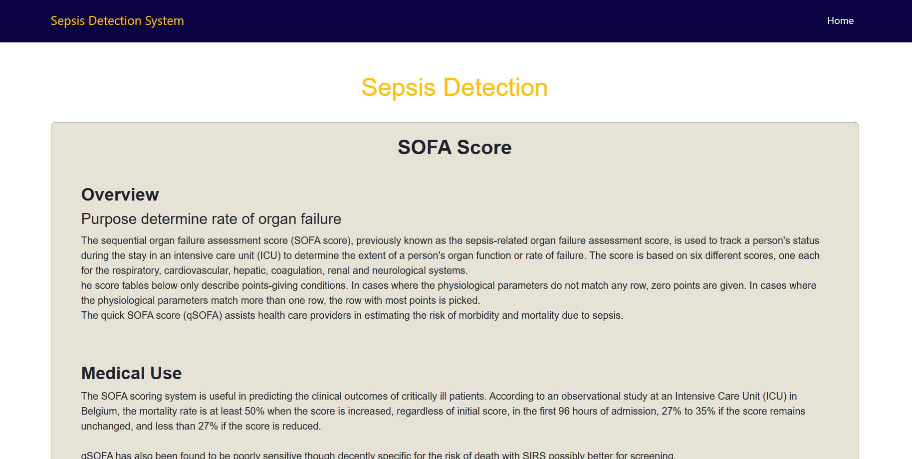
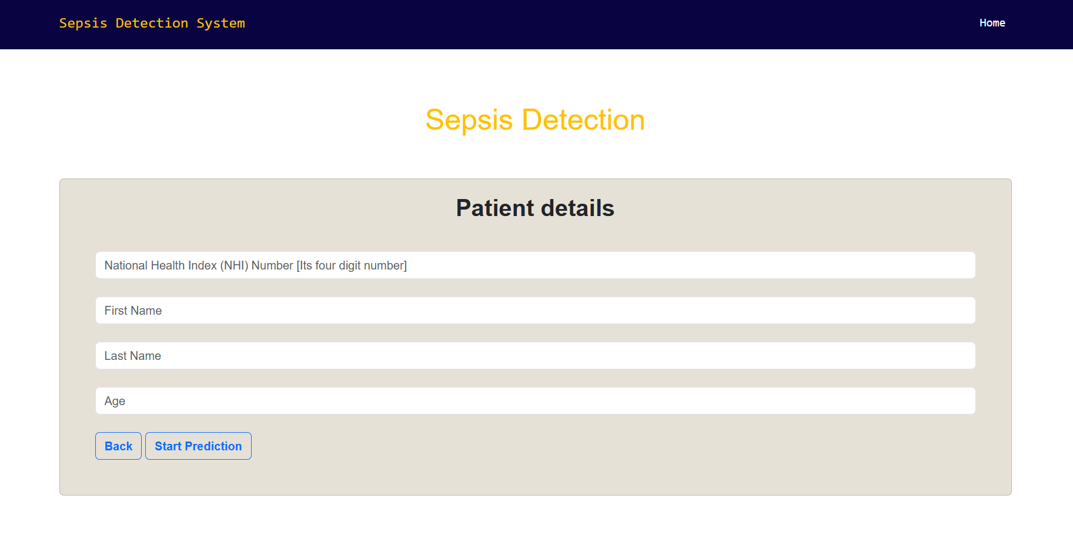
OUTPUTS

Slide 17
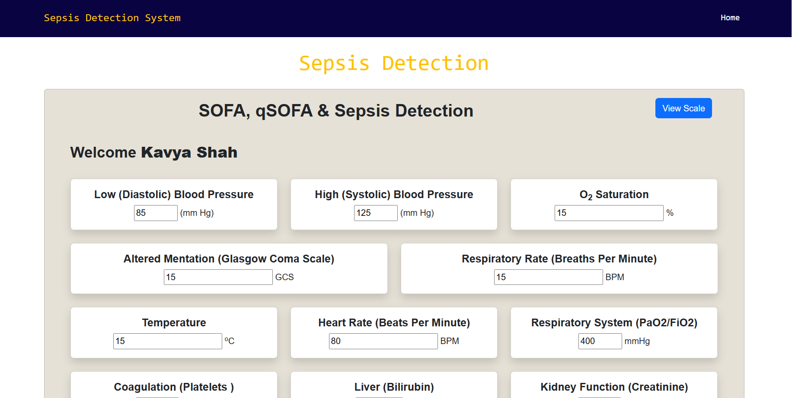
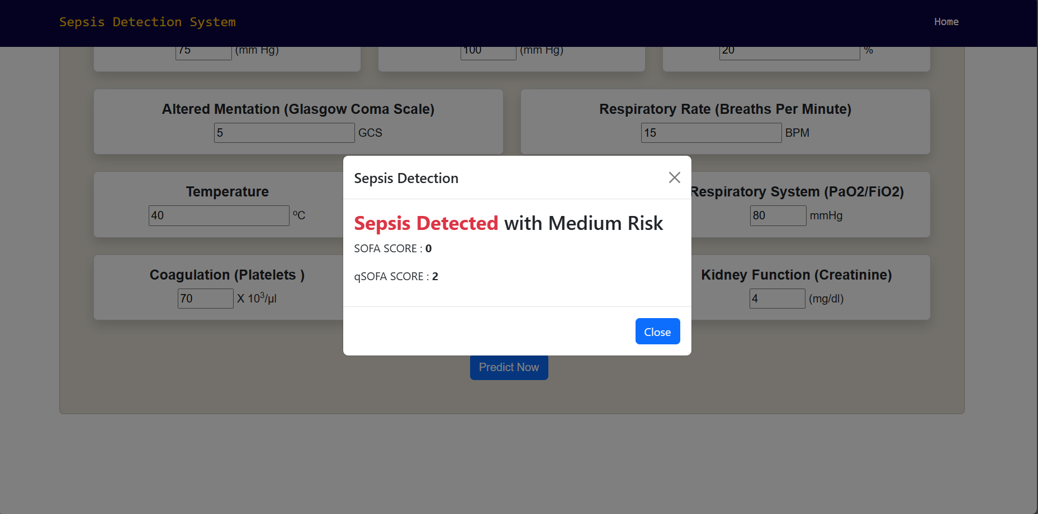
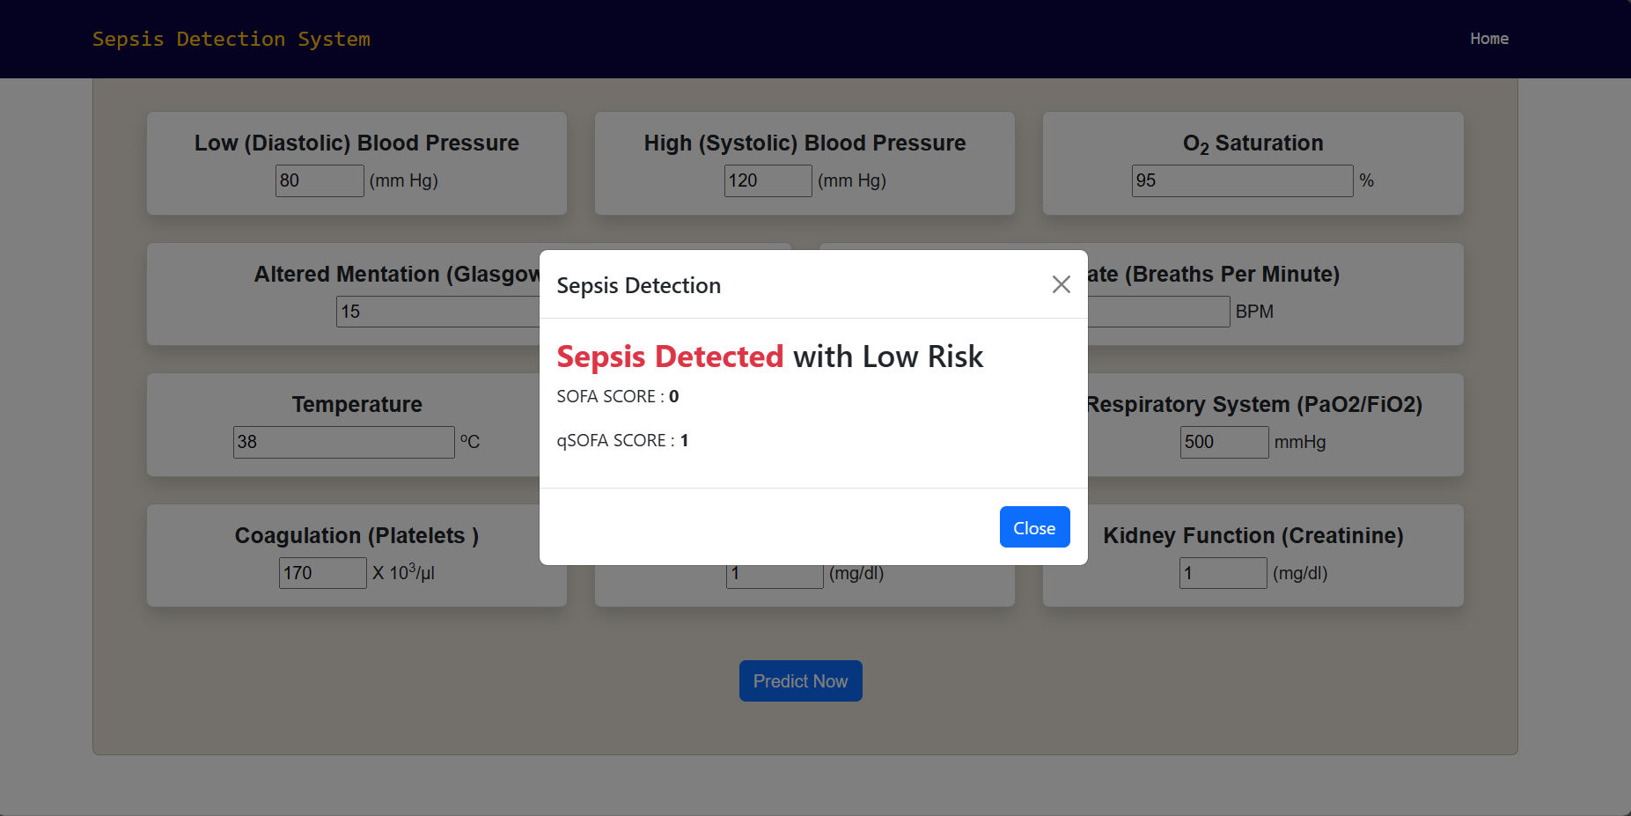
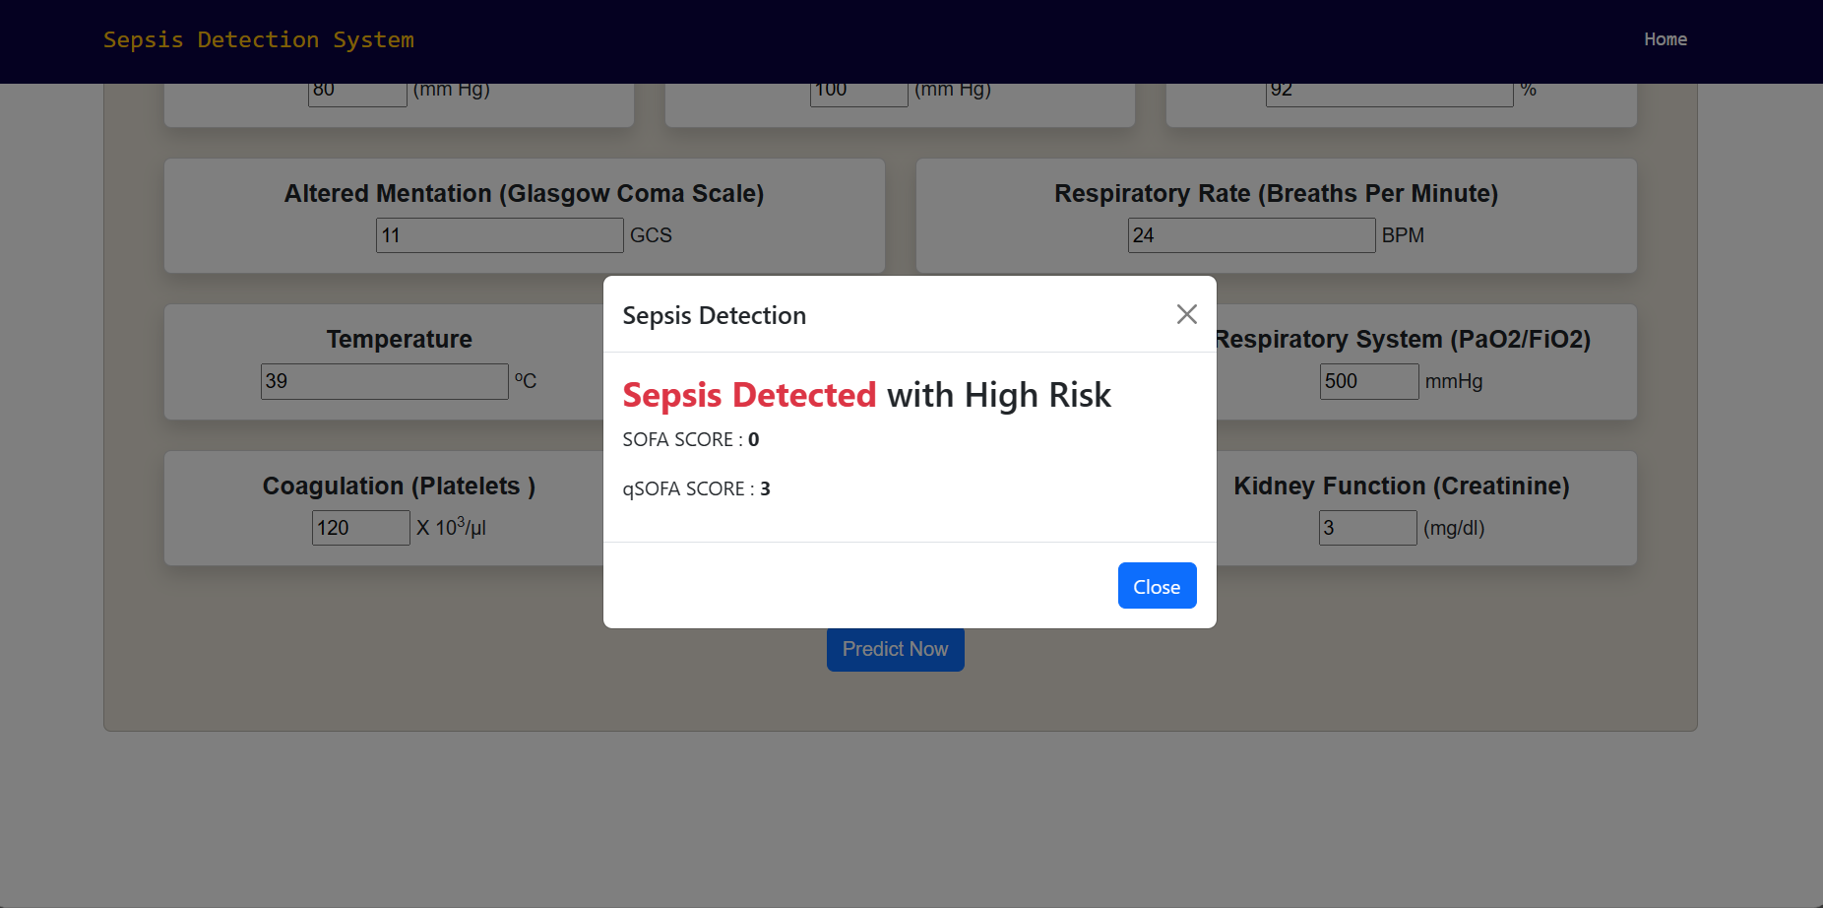

Slide 18
CONCLUSION
Our comprehensive analysis and prediction system for sepsis using the SOFA score, qSOFA, and machine learning models represent a significant step forward in the early identification and management of this life-threatening condition. By improving the accuracy of sepsis prediction, we are working to save lives and enhance patient outcomes. Our commitment to data analysis, model development, and user-friendly interfaces underscores the potential for more effective sepsis care in the future.

Slide 19
REFERENCES
Anurag Shankar, Mufaddal Diwan, Snigdha Singh, Husain Nahrpurawala and Tanusri Bhowmick, “Early Prediction of Sepsis using Machine Learning,” IEEE 2021.
B. C. Srimedha, Rashmi Naveen Raj, And Veena Mayya, “A Comprehensive Machine Learning Based Pipeline for an Accurate Early Prediction of Sepsis in ICU”, IEEE access 2022.
Guilan Kong, Ke Lin, and Yonghua Hu,” Using machine learning methods to predict in-hospital mortality of sepsis patients in the ICU”, 2020, Published by BMC.
Yash Veer Singh, Pushpendra Singh, Shadab Khan, and Ram Sewak Singh, “A Machine Learning Model for Early Prediction and Detection of Sepsis in Intensive Care Unit Patients”, 2022, Published by Hindawi.
Longxiang Su, Zheng Xu, Fengxiang Chang, Yingying Ma, “Early Prediction of Mortality, Severity, and Length of Stay in the Intensive Care Unit of Sepsis Patients Based on Sepsis 3.0 by Machine Learning Models”, 2021, Published by Frontiers.
S. Kanaga Suba Raja, K. Valarmathi, S. Deepthi Sri, “Sepsis prediction using ensemble random forest”, 2022, Published by AIP Conference Proceedings.
S. Babu, Lalitha Anupama Annavarapu, Lakshmi Lahari Appala, “Sepsis Detection using Neural Networks”, 2022, Published by SMART GENCON.

Slide 20
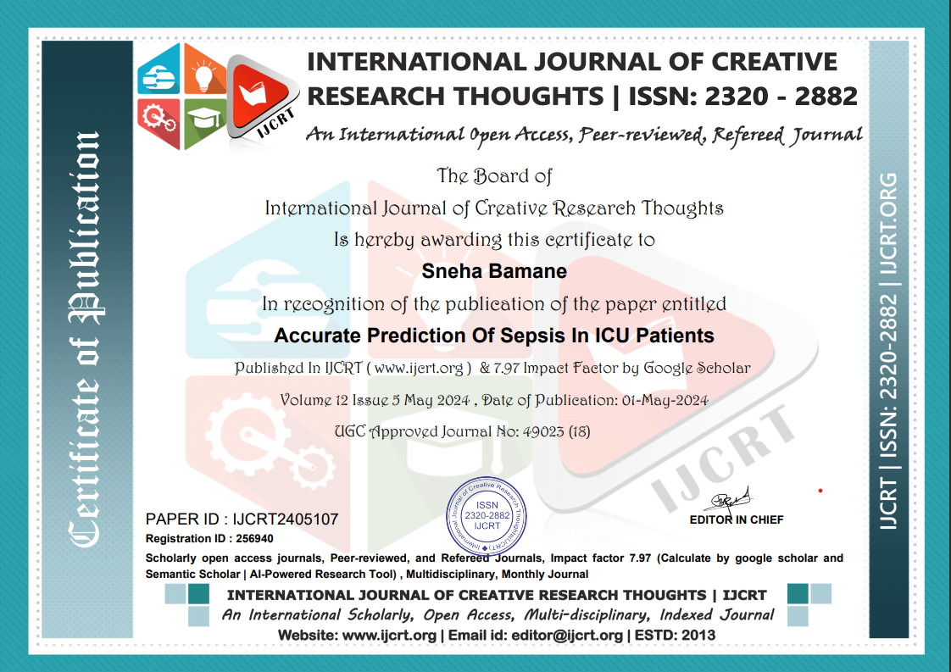
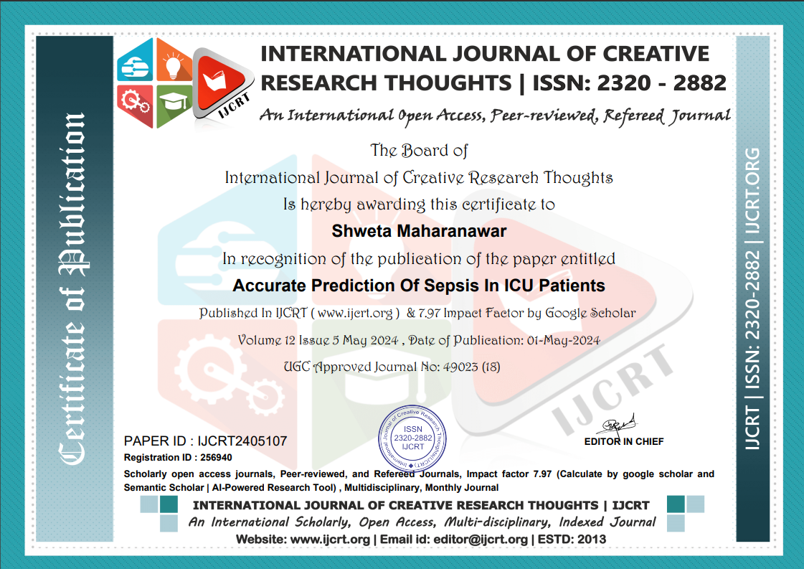


Slide 21
Thank You!

